Slide 1
CAPSTONE PROJECT PRESENTATION
By FE/23/18625462

Slide 2
Data Preprocessing
Here, I wrote a code to find out missing values and was able to visualize that

Slide 3
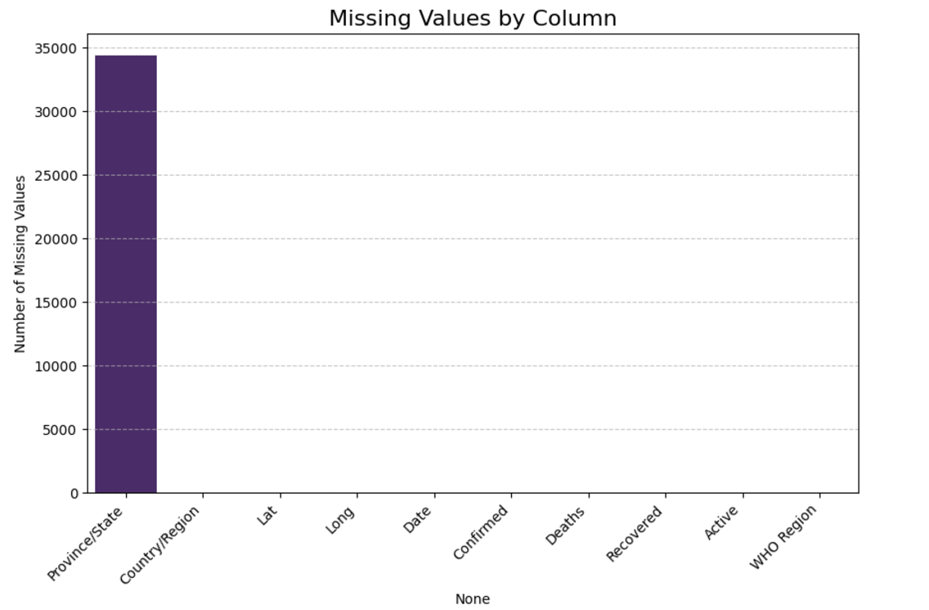
Missing values

Slide 4
Exploratory Data Analysis (EDA)
I was took a sneak peak at the confirmed cases in all the countries captured in the data. The next slide shows the confirmed cases ranking of the first ten.

Slide 5
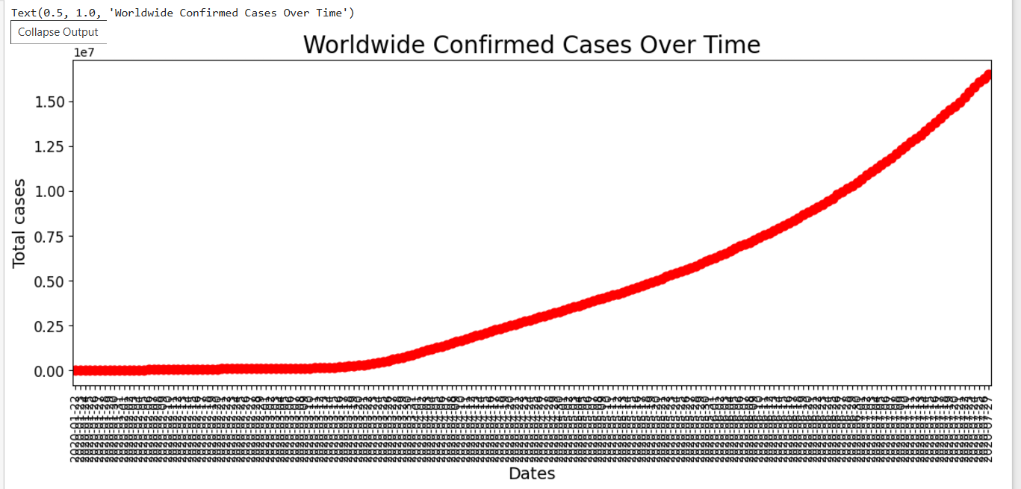
Confirmed cases over time

Slide 6
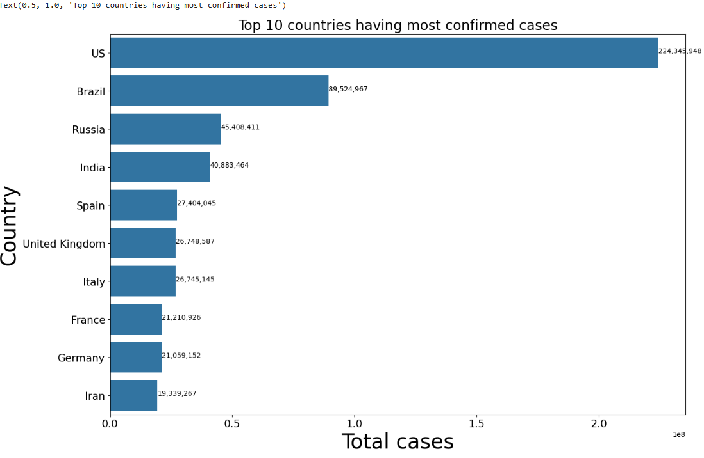
Confirmed cases country ranking

Slide 7
Model Development
This involves predicting the data to see its behaviour in subsequent years. The results shows that there will be a gross decline in COVID-19 cases in the years to come. This I presume is as a result of more improvement in the combat against the pandemic.

Slide 8
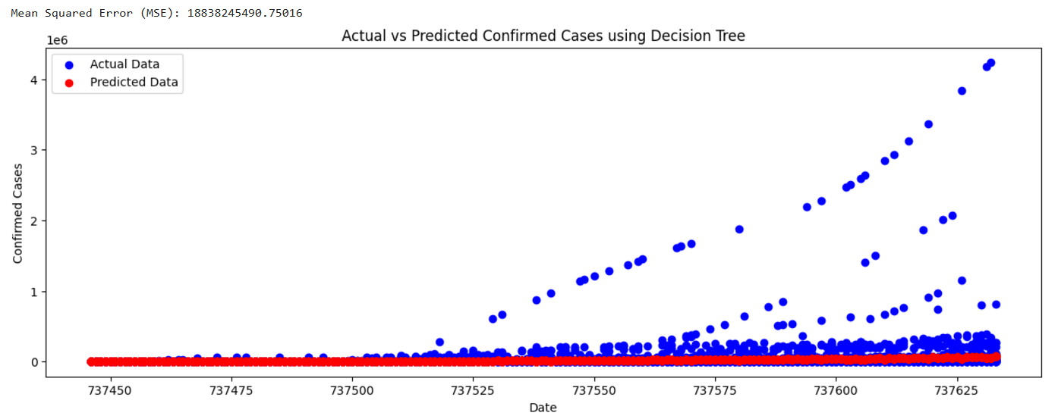
Decision Tree Regressor

Slide 9
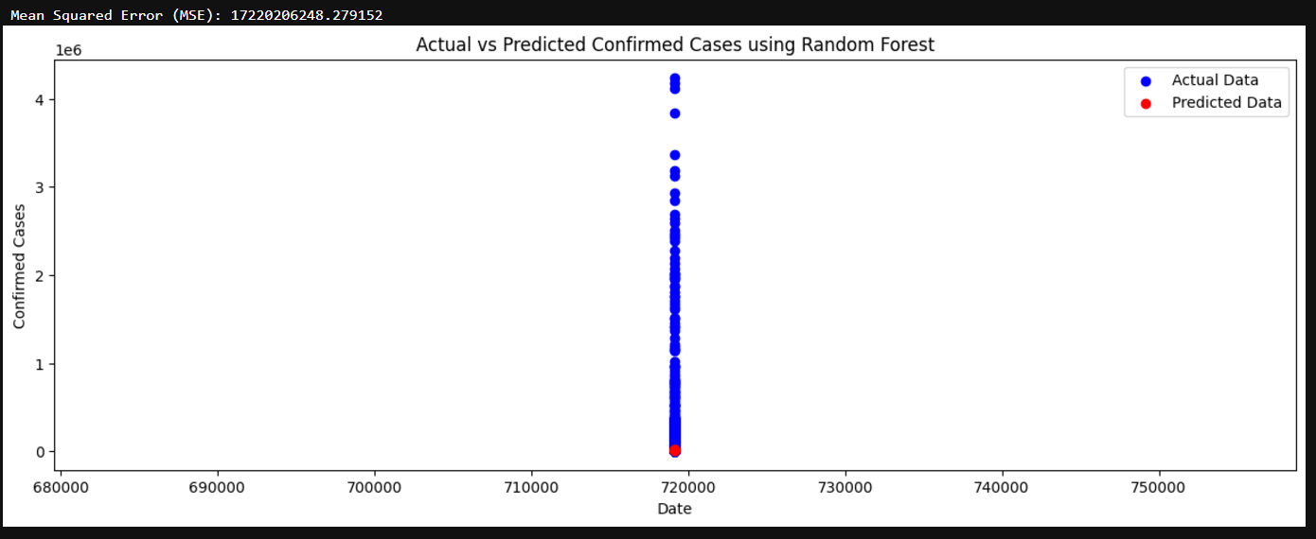
Random Forest Regressor

Slide 10
Recommendation
Since the fight against COVID-19 has not been totally won, I recommend that all health organizations and governments should not relent in tackling this menace but to continually remain resolute. They should also continually educate the populace on safety health tips as all is involved in this fight.

